Slide 1
Software Engineering
Lesson topic – Design Patterns

Slide 2
Lesson Content
What are design patterns
Strengths and problems with design patterns
3 types of design patterns
Examples of design patterns
Singleton
Factory (and Abstract Factory)
Strategy
Decorator
Composite

Slide 3
Design Patterns
Benefits, Types, Examples

Slide 4
What is a Design Pattern?
A design pattern is a general repeatable solution to a commonly occurring problem in software design.
A design pattern systematically names, motivates, and explains a general design that addresses a recurring design problem in object-oriented systems.
It describes the problem, the solution, when to apply the solution, and its consequences.
The solution is a general arrangement of objects and classes that solve the problem.

Slide 5
What is a Design Pattern?
Each pattern has the same elements
Pattern Name – helps develop a catalog of common problems
Problem – describes when to apply the pattern. Describes problem and its context.
Solution – Elements that make up the design, their relationships, responsibilities, and collaborations.
Consequences – Results and trade-offs of applying the pattern
5

Slide 6
Why design patterns?
“Someone has already solved your problems”
Reuse!! (not same as copy-paste)
Example: Programmers make use of APIs and functionality they give you
But they don’t help the structure of the application to be more flexible and maintainable
Design patterns are higher level than libraries and APIs, they tell HOW TO STRUCTURE classes and objects to solve certain problems.
It is the job of software engineer to adapt it to a particular application
Solutions based on design patterns are easily reusable, extendable, maintainable

Slide 7
3 Types of Design Patterns
Creational
Structural
Behavioral
Deal with the process of object creation/instantiation
Deal with the larger composition of classes /objects
Deal with the ways in which classes/objects interact and distribute responsibility

Slide 8
Types of Design Patterns cont…
Creational
Factory Method
Abstract Factory
Builder
Prototype
Structural
Composite
Proxy
Behavioral
Iterator
Observer
Adapter
Façade
Decorator
Strategy
Command
Template Method
Singleton

Slide 9
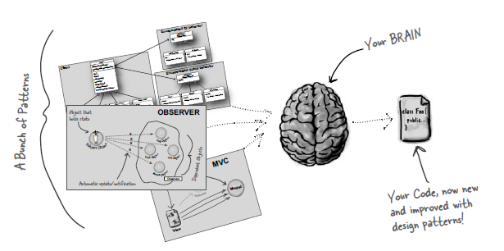
How to Use Design Patterns
The solution should be customized and implemented to solve the problem in a particular context.

Slide 10
10 Principles for Design Patterns
Encapsulate things that are likely to vary, away from things that will stay the same.
Code to an interface, not an implementation
Open-Closed Principle – classes should be open to extension but closed to modification
Avoid code duplication – abstract common behavior and reuse it in other classes
Single Responsibility – every object should have one main responsibility

Slide 11
10 Principles for Design Patterns
Inheritance should be well designed
Don’t depend on concrete classes but on abstractions
Interface segregation – don’t depend on interfaces that are not used
Talk only to immediate friends
Interacting objects should be loosely coupled

Slide 12
Creational Patterns
Deal with the process of object creation/instantiation

Slide 13
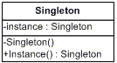
Singleton Pattern
Definition: “The Singleton Pattern ensures a class has only one instance, and provides a global point of access to it.”
The main idea behind this design is that we cannot allow other parts of the program (other objects) to call the new() constructor of this class since that would instantiate multiple instances of it.
For this reason the constructor must
be called from within the class itself
and should not be visible to other
classes – therefore not public.

Slide 14
Singleton Pattern UML Class Diagram
The only function that is visible externally is getInstance() which returns the Singleton Object itself

Slide 15
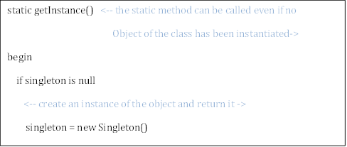
Singleton Pattern UML Class Diagram
Pseudocode for the getInstance() method would be:

Slide 16
Singleton Pattern
Best Uses
Logging
Caches
Registry Settings
Access External Resources
Printer
Device Driver
Database

Slide 17
Logger – as a Singleton
Logger
- uniqueInstance : Logger
Logger ()
+ getInstance(): Logger
Note the parameterless constructor

Slide 18
Logger – as a Singleton
public class Logger
{
private Logger{}
private static Logger uniqueInstance;
public static Logger getInstance()
{
if (uniqueInstance == null)
uniqueInstance = new Logger();
return uniqueInstance;
}
}
Note the parameterless constructor

Slide 19
Singleton vs. Static Variables
Let’s pretend the Logger() constructor did a lot of setup.
Ideally, we would want this to be carried out only once!
What if we had not created a Singleton for the Logger class??
In our main program file, we had this code:
public static Logger MyGlobalLogger = new Logger();
Without the Singleton Pattern , all of the Logger setup will occur regardless if we ever need to log or not.

Slide 20
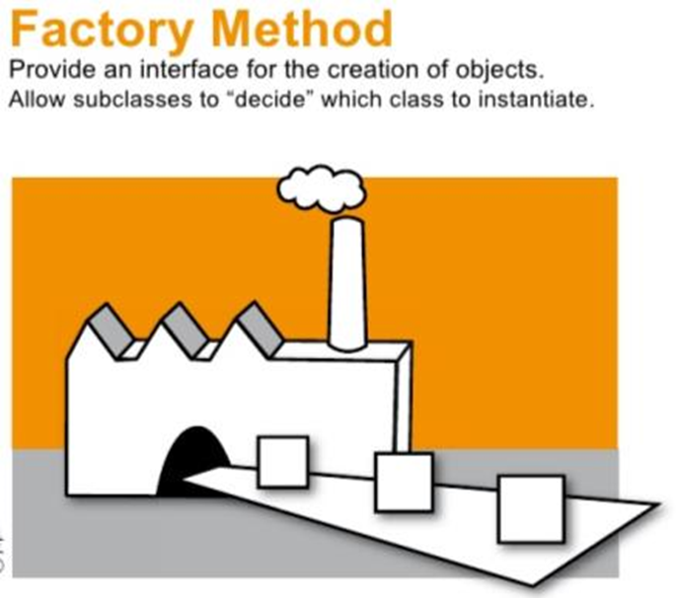
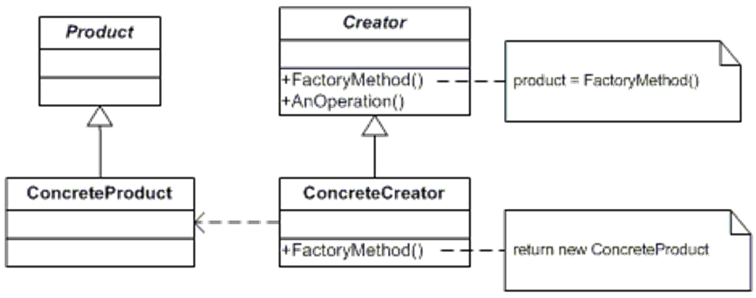
Factory Pattern
The Factory Method Pattern proposed the creation of a Factory class that delegates the instantiation of the required objects as necessary.
Best Used when a number of variations on the same object need to be created.

Slide 21


Factory Pattern
In Factory pattern, we create object without exposing the creation logic to the client and refer to newly created object using a common interface.
Define an interface for creating an object, but let subclass decide which class to instantiate

Slide 22
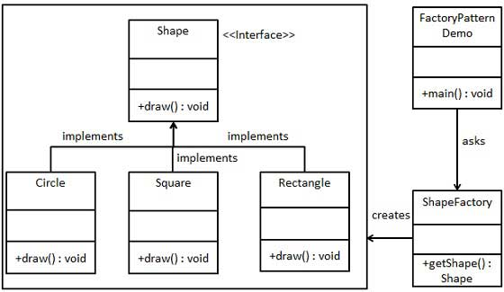
Factory Pattern UML Class Diagram

Slide 23
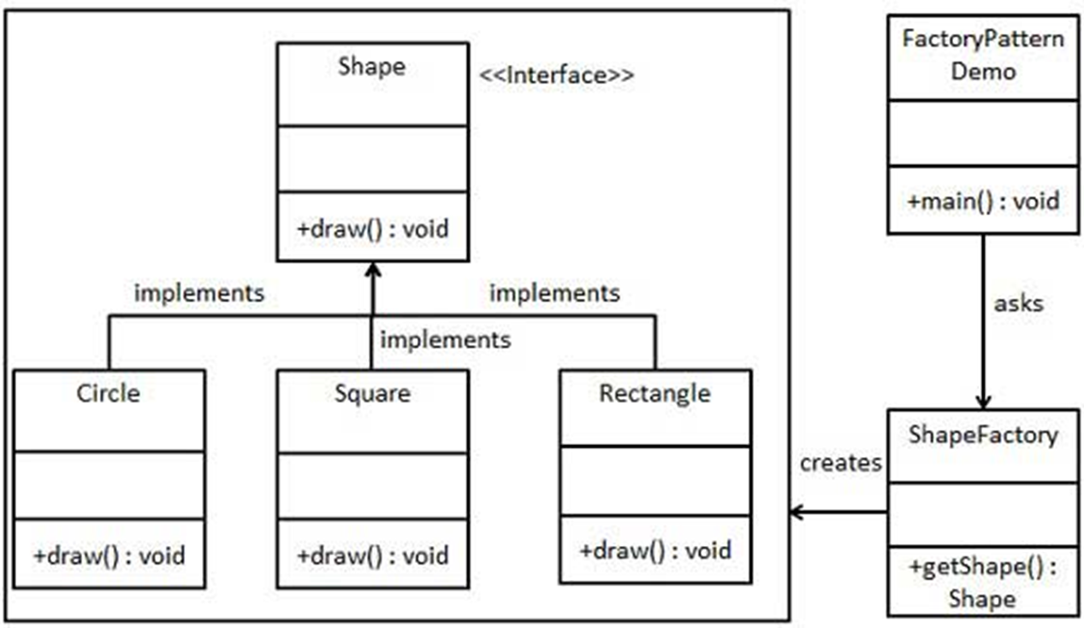
Factory Pattern UML Class Diagram
FactoryPatternDemo, will use ShapeFactory to get a Shapeobject.
It will pass information (CIRCLE / RECTANGLE / SQUARE) to ShapeFactory to get the type of object it needs.

Slide 24

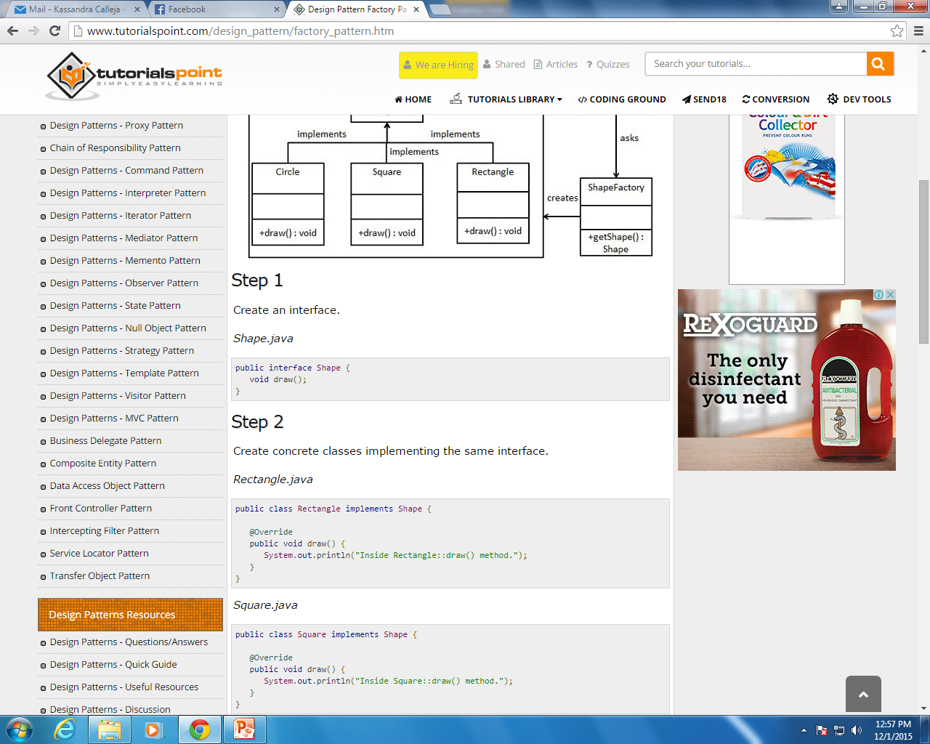

Factory Pattern
Step 1
Create the interface Shape
Step 2
Create concrete classes implementing the same interface.

Slide 25
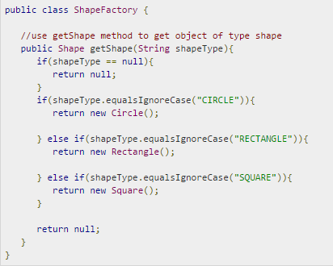
Factory Pattern
Step 3
Create the Factory Class to generate object of concrete class based on given information.

Slide 26
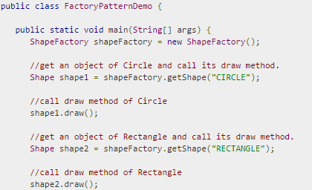
Factory Pattern
Step 4
Use an instance of the Factory Class to get object of concrete class by passing an information such as type.

Slide 27
Factory Pattern UML Class Diagram

Slide 28
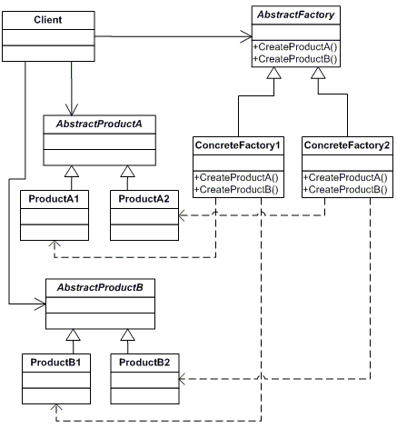
Abstract Factory Pattern

Slide 29
Abstract Factory Pattern
Abstract Factory patterns work around a super-factory which creates other factories.
This factory is also called as factory of factories.
An interface is responsible for creating a factory of related objects without explicitly specifying their classes. Each generated factory can give the objects as per the Factory pattern.

Slide 30
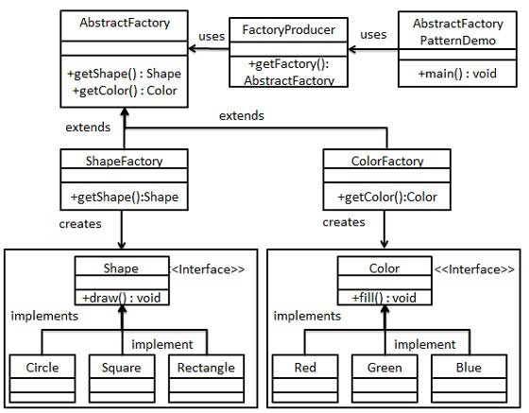
Abstract Factory Pattern UML Diagram

Slide 31
Abstract Factory Pattern UML Diagram
AbstractFactoryPatternDemo, uses FactoryProducer to get an AbstractFactory object.
It passes information for Shape (CIRCLE / RECTANGLE / SQUARE) to AbstractFactory to get the type of object it needs.
It passes information for Color (RED / GREEN / BLUE ) to AbstractFactory to get the type of object it needs.

Slide 32
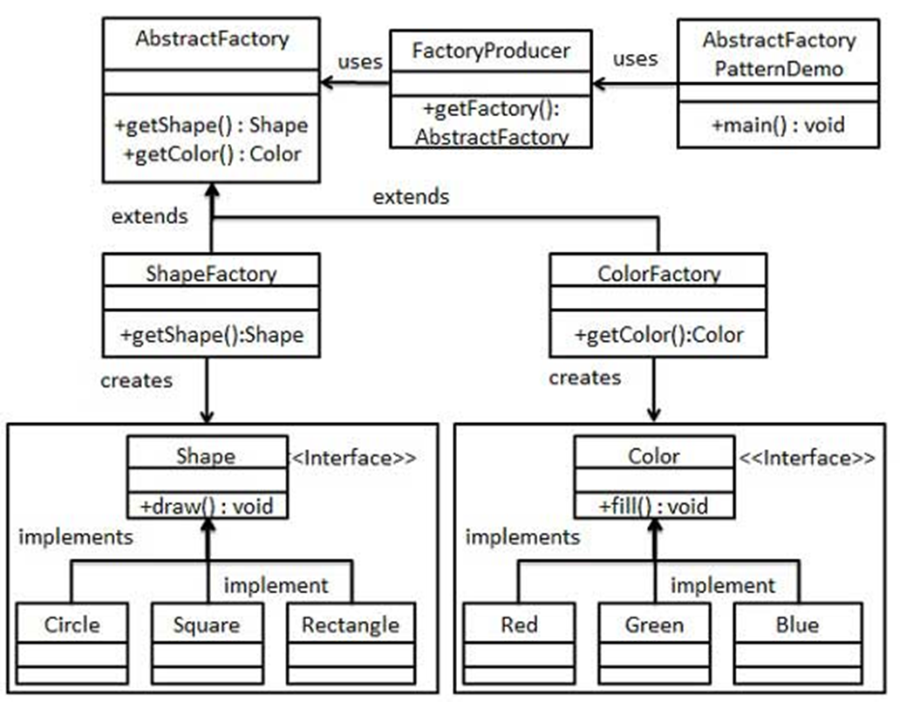
Abstract Factory Pattern UML Diagram
Step 1
Create Interface Shape
Concrete Classes :
Circle, Square and Rectangle
Step 2
Create Interface Color
Concrete Classes :
Red, Green and Blue

Slide 33
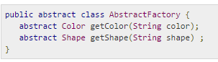
Abstract Factory Pattern UML Diagram
Step 3
Create an Abstract class to get factories for Color and Shape Objects

Slide 34
Abstract Factory Pattern UML Diagram
Step 4
Create Factory classes for Shape and Color extending AbstractFactory to generate object of concrete class based on given information.

Slide 35
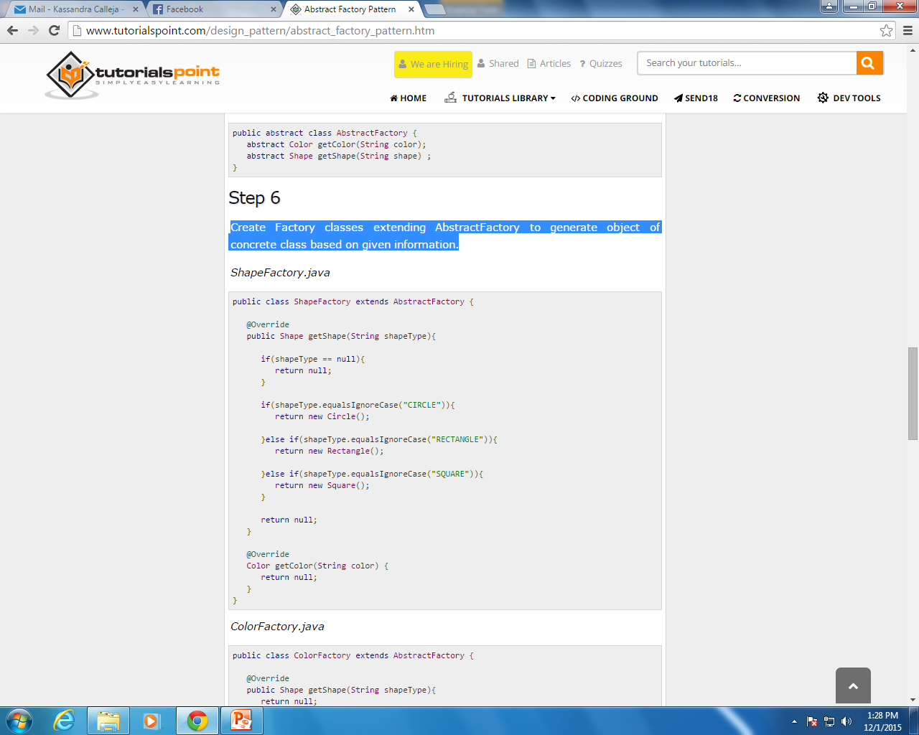
Abstract Factory Pattern UML Diagram
Step 4

Slide 36
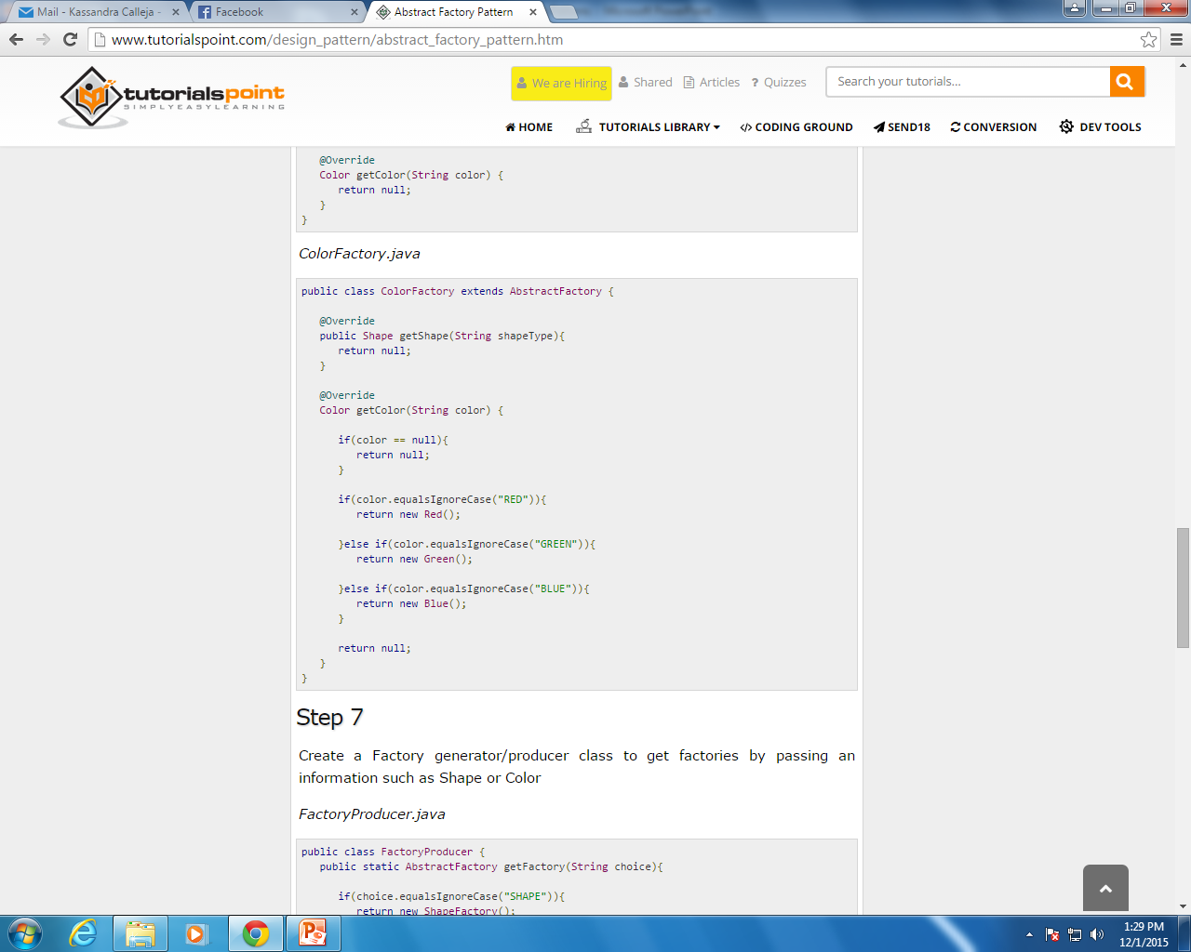
Step 4

Slide 37
Abstract Factory Pattern UML Diagram
Step 5
Create a Factory generator/producer class to get factories by passing an information such as Shape or Color

Slide 38
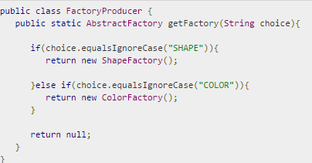
Abstract Factory Pattern UML Diagram
Step 5
Create a Factory generator/producer class to get factories by passing an information such as Shape or Color

Slide 39

Abstract Factory Pattern UML Diagram
Step 6
Use the FactoryProducer to get AbstractFactory in order to get factories of concrete classes by passing an information e.g. type

Slide 40
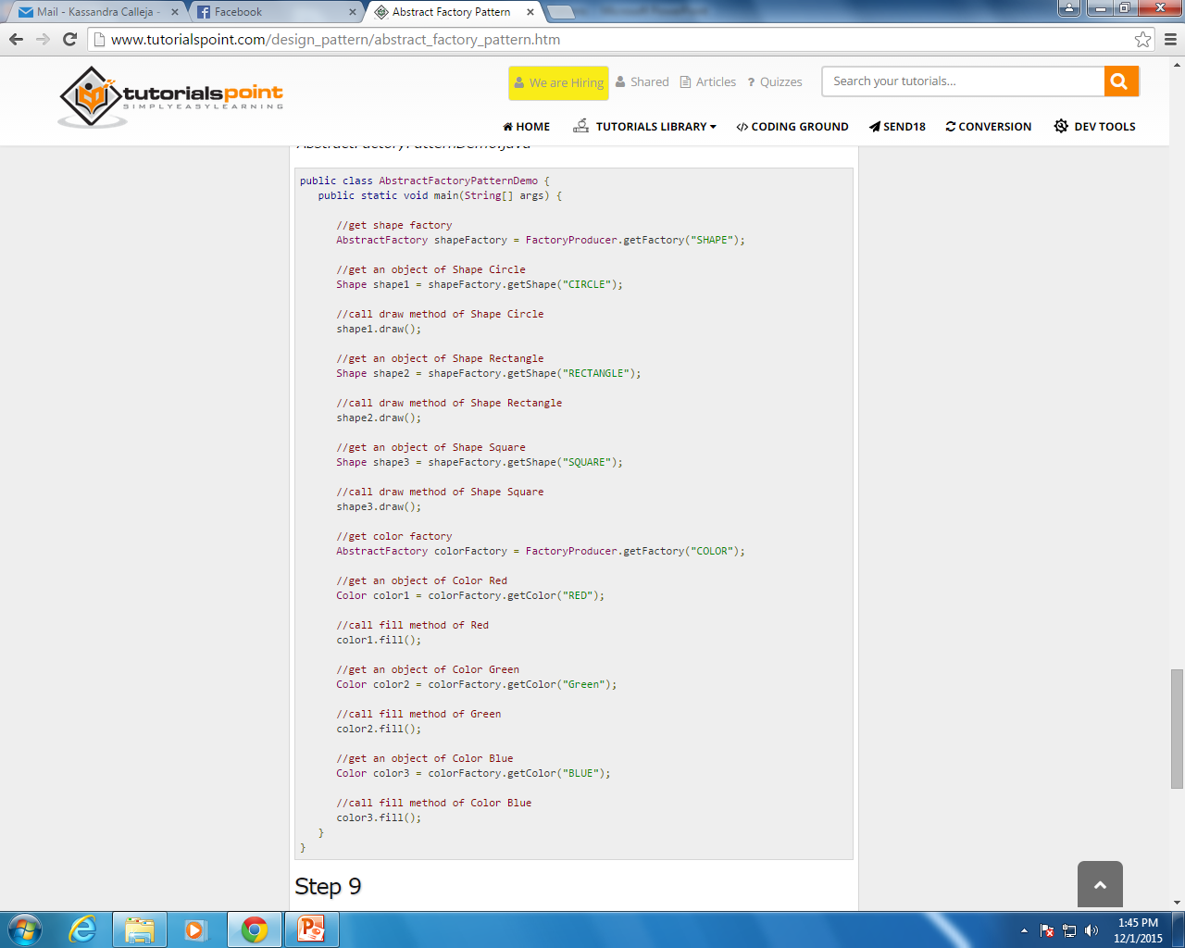
Abstract Factory Pattern UML Diagram
Step 6

Slide 41
Reference List
[1] Blackwell, T, 2006, Software engineering, algorithm design and analysis: volume 1, p 3, Goldsmiths College, University of London
[2] Fowler M, 2003, UML Distilled. A Brief Guide to Standard Object Modelling Language, Addison Wesley, 3rd edition

Slide 42

End of Lesson
Any questions?

